Slide 1
The Data Link Layer
Chapter 3

Slide 2
Data Link Layer Design Issues
Network layer services
Framing
Error control
Flow control

Slide 3
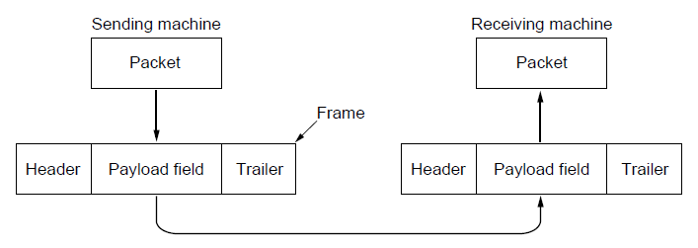
Packets and Frames
Relationship between packets and frames.

Slide 4
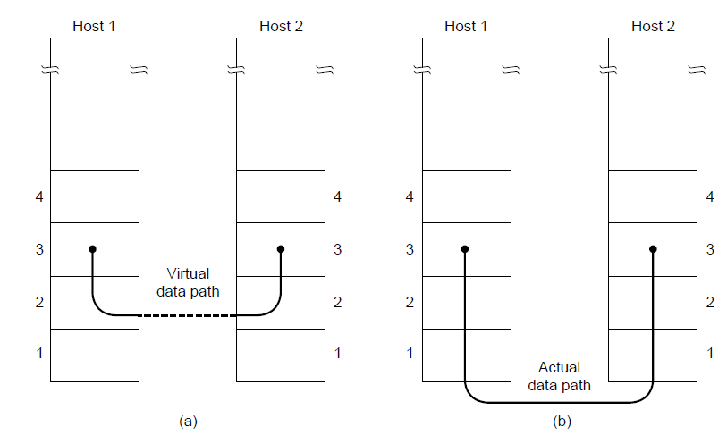
Network Layer Services
(a) Virtual communication. (b) Actual communication.

Slide 5
Possible Services Offered
Unacknowledged connectionless service.
Acknowledged connectionless service.
Acknowledged connection-oriented service.

Slide 6
Framing Methods
Byte count.
Flag bytes with byte stuffing.
Flag bits with bit stuffing.
Physical layer coding violations.

Slide 7
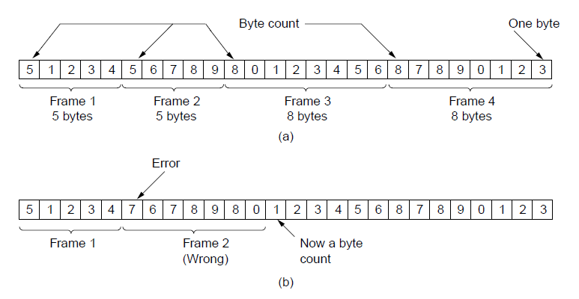
Framing (1)
A byte stream. (a) Without errors. (b) With one error.

Slide 8
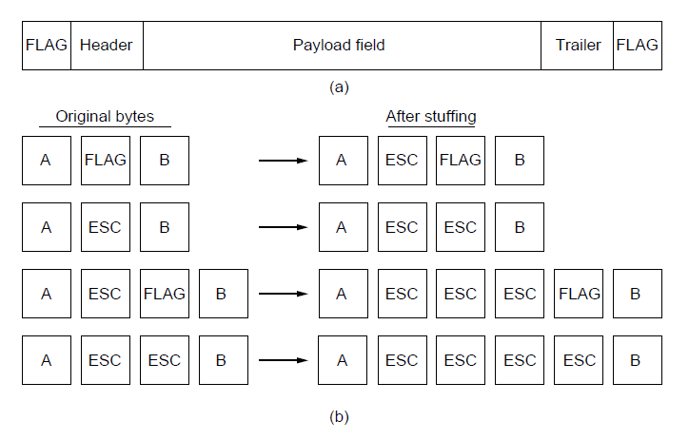
Framing (2)
A frame delimited by flag bytes.
Four examples of byte sequences before and after byte stuffing.

Slide 9
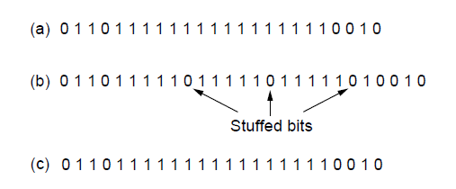
Framing (3)
Bit stuffing. (a) The original data. (b) The data as they appear on
the line. (c) The data as they are stored in the receiver’s memory after destuffing.

Slide 10
Error Detection Codes (1)
Hamming codes.
Binary convolutional codes.
Reed-Solomon codes.
Low-Density Parity Check codes.

Slide 11
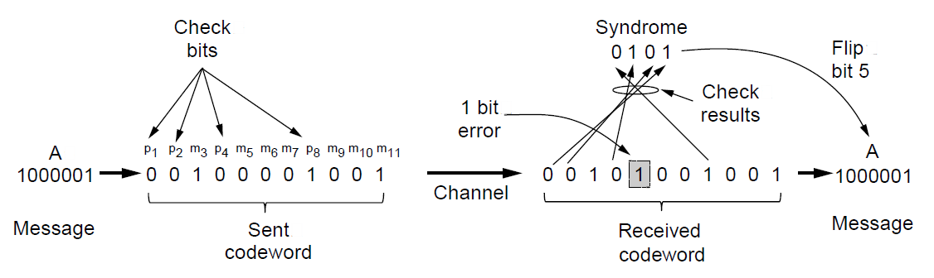
Error Detection Codes (2)
Example of an (11, 7) Hamming code
correcting a single-bit error.

Slide 12
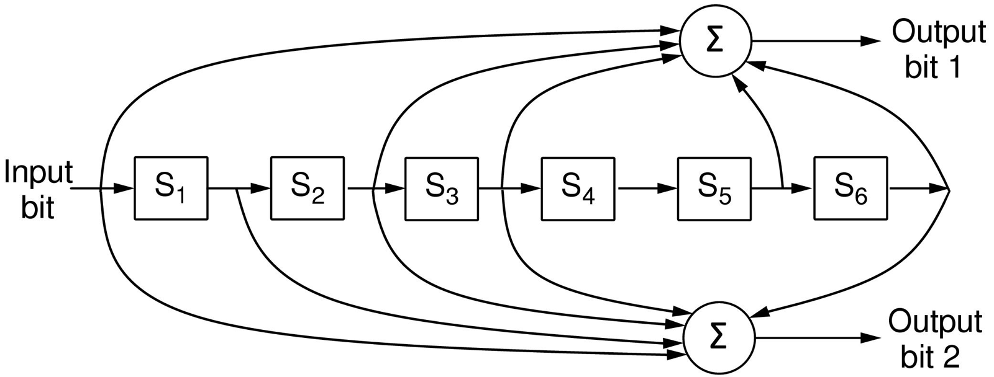
Error Detection Codes (3)
The NASA binary convolutional code used in 802.11.

Slide 13
Error-Detecting Codes (1)
Linear, systematic block codes
Parity.
Checksums.
Cyclic Redundancy Checks (CRCs).

Slide 14
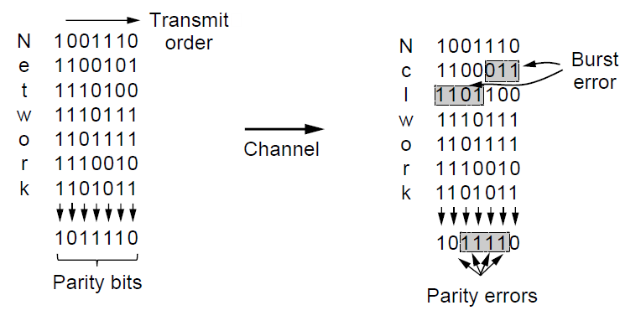
Error-Detecting Codes (2)
Interleaving of parity bits to detect a burst error.

Slide 15
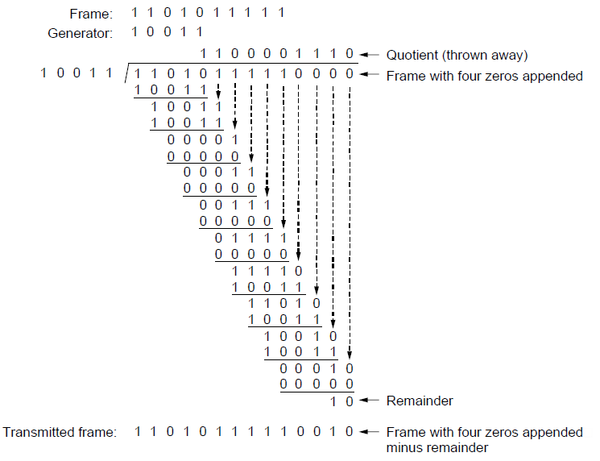
Error-Detecting Codes (3)
Example calculation of the CRC

Slide 16
Elementary Data Link Protocols (1)
Utopian Simplex Protocol
Simplex Stop-and-Wait Protocol
  Error-Free Channel
Simplex Stop-and-Wait Protocol
  Noisy Channel

Slide 17
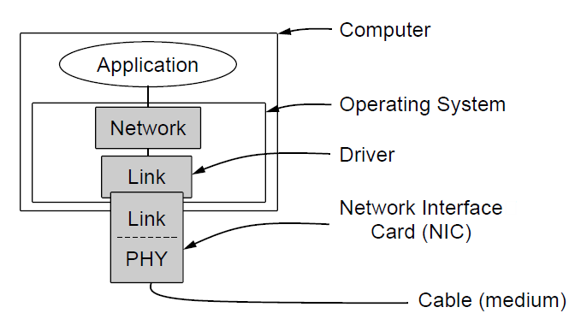
Elementary Data Link Protocols (2)
Implementation of the physical, data link, and network layers.

Slide 18
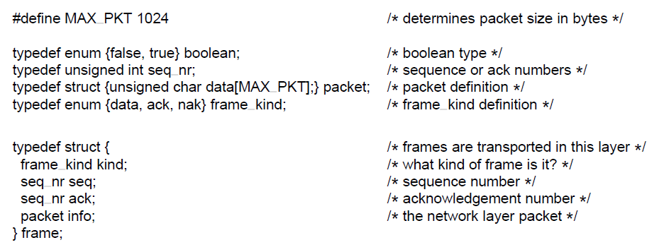
Elementary Data Link Protocols (3)
. . .
Some definitions needed in the protocols to follow. These definitions are located in the file protocol.h.

Slide 19
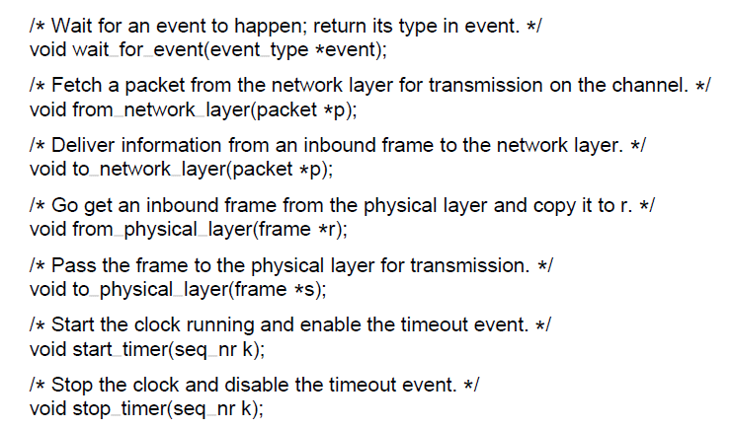
Elementary Data Link Protocols (4)
. . .
Some definitions needed in the protocols to follow. These definitions are located in the file protocol.h.

Slide 20
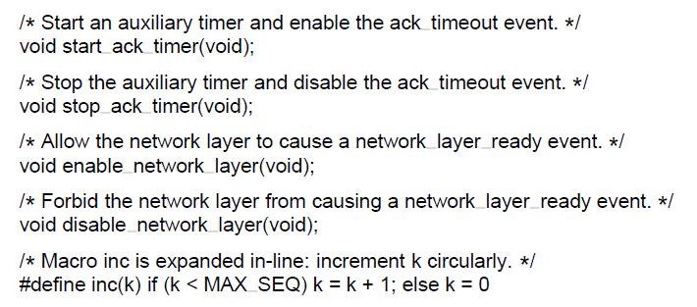
Elementary Data Link Protocols (5)
Some definitions needed in the protocols to follow. These definitions are located in the file protocol.h.

Slide 21
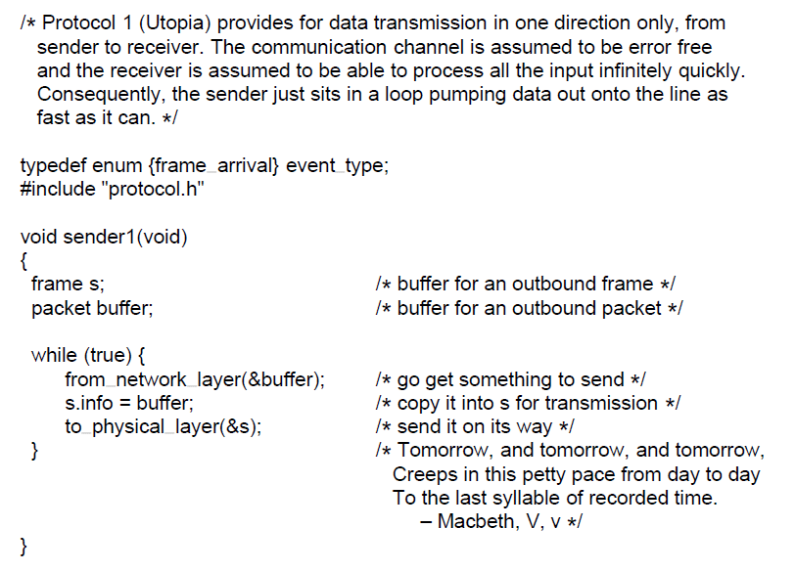
Utopian Simplex Protocol (1)
. . .
A utopian simplex protocol.

Slide 22
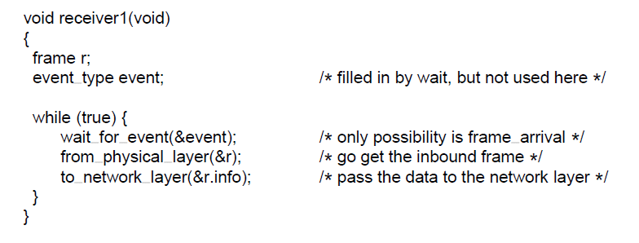
Utopian Simplex Protocol (2)
A utopian simplex protocol.

Slide 23
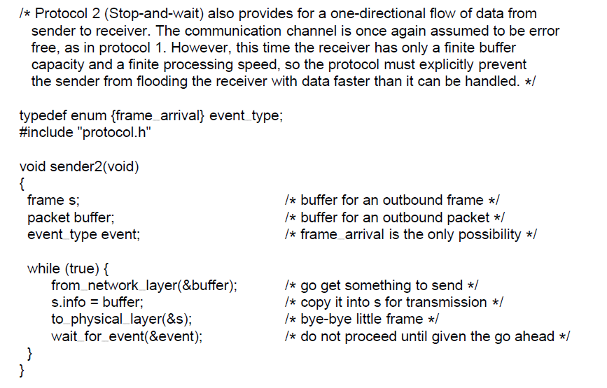
Simplex Stop-and-Wait Protocol for a Noisy Channel (1)
. . .
A simplex stop-and-wait protocol.

Slide 24
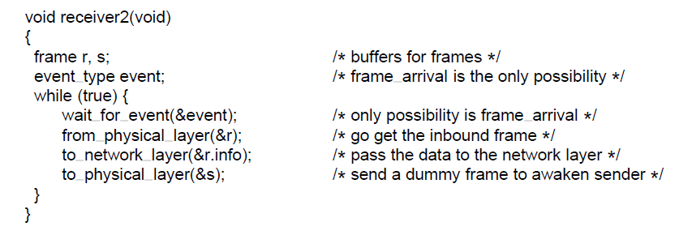
Simplex Stop-and-Wait Protocol for a Noisy Channel (2)
A simplex stop-and-wait protocol.

Slide 25
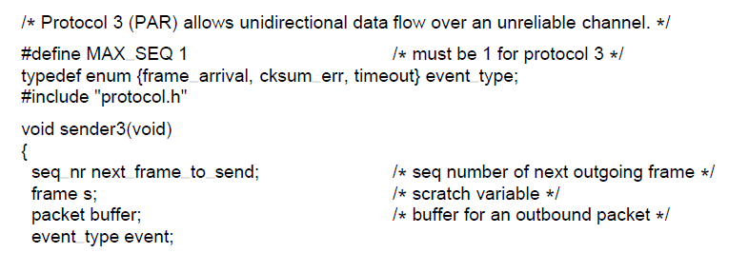
Sliding Window Protocols (1)
. . .
A positive acknowledgement with retransmission protocol.

Slide 26
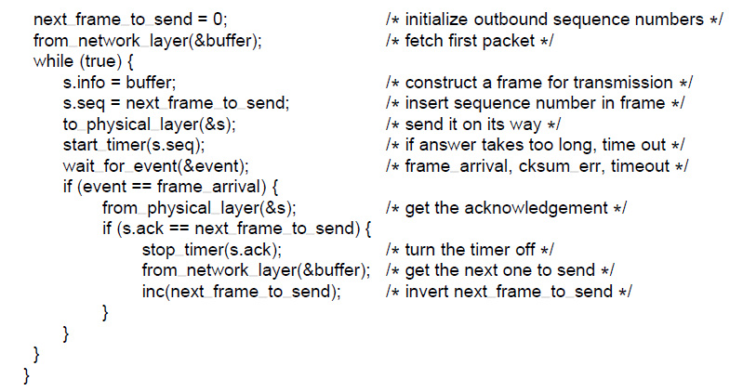
Sliding Window Protocols (2)
. . .
A positive acknowledgement with retransmission protocol.

Slide 27
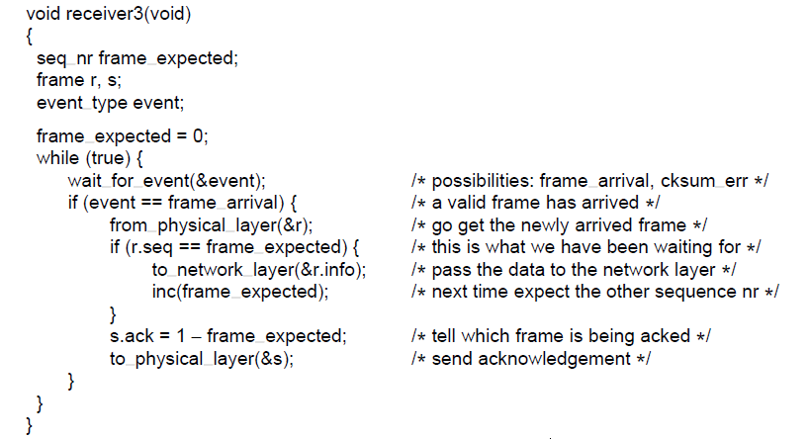
Sliding Window Protocols (3)
A positive acknowledgement with retransmission protocol.

Slide 28
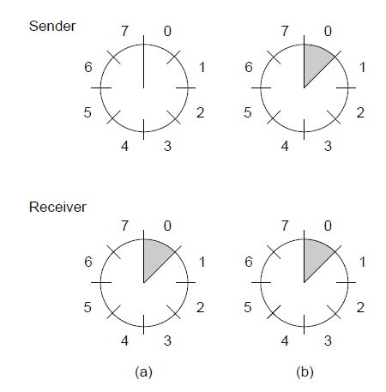
Sliding Window Protocols (4)
A sliding window of size 1, with a 3-bit sequence number.
(a) Initially. (b) After the first frame has been sent.

Slide 29
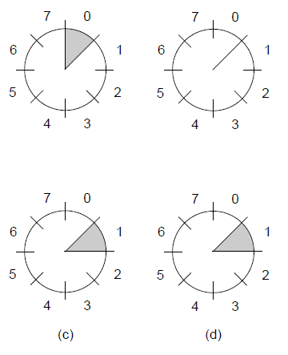


Sliding Window Protocols (5)
A sliding window of size 1, with a 3-bit sequence number
(c) After the first frame has been received. (d) After the first acknowledgement has been received.

Slide 30
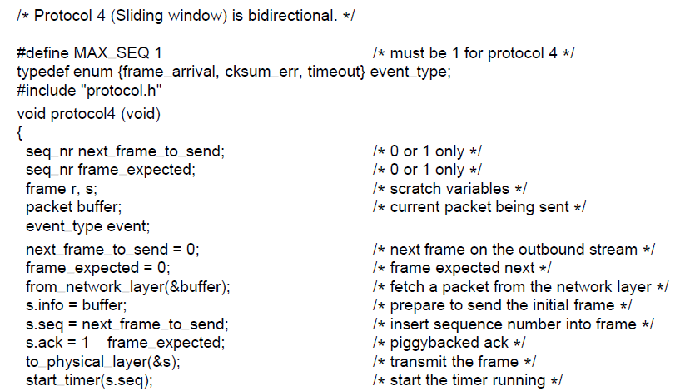
One-Bit Sliding Window Protocol (1)
. . .
A 1-bit sliding window protocol.

Slide 31
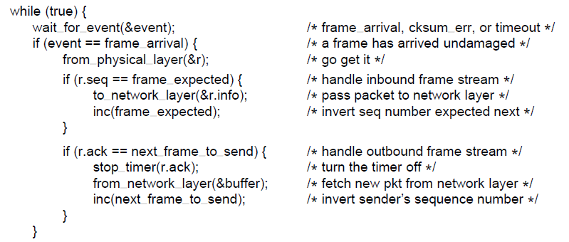
One-Bit Sliding Window Protocol (2)
. . .
A 1-bit sliding window protocol.

Slide 32
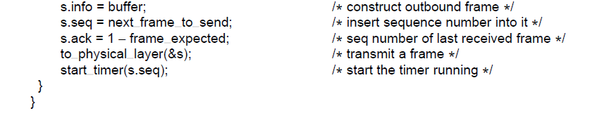
One-Bit Sliding Window Protocol (3)
A 1-bit sliding window protocol.

Slide 33
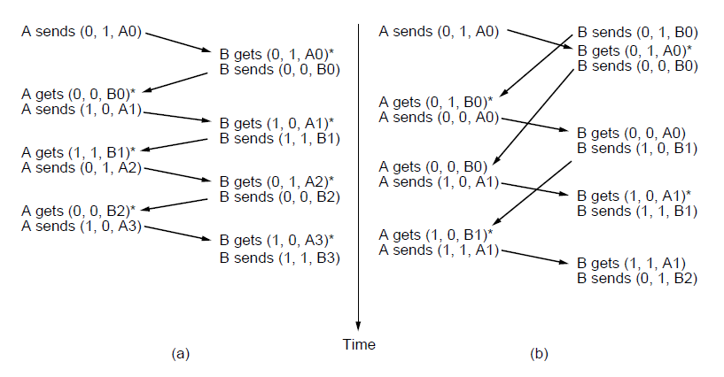
One-Bit Sliding Window Protocol (4)
Two scenarios for protocol 4. (a) Normal case. (b) Abnormal
case. The notation is (seq, ack, packet number). An asterisk indicates where a network layer accepts a packet

Slide 34
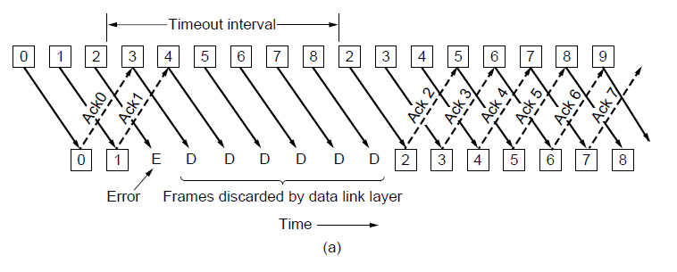
Protocol Using Go-Back-N (1)
Pipelining and error recovery. Effect of an error when
(a) receiver’s window size is 1

Slide 35
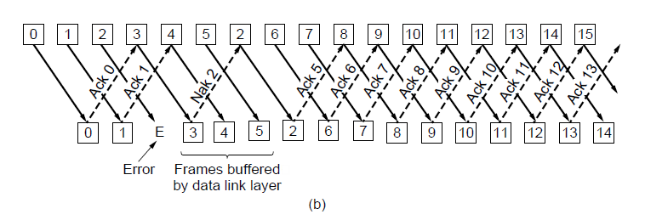
Protocol Using Go-Back-N (2)
Pipelining and error recovery. Effect of an error when
(b) receiver’s window size is large.

Slide 36
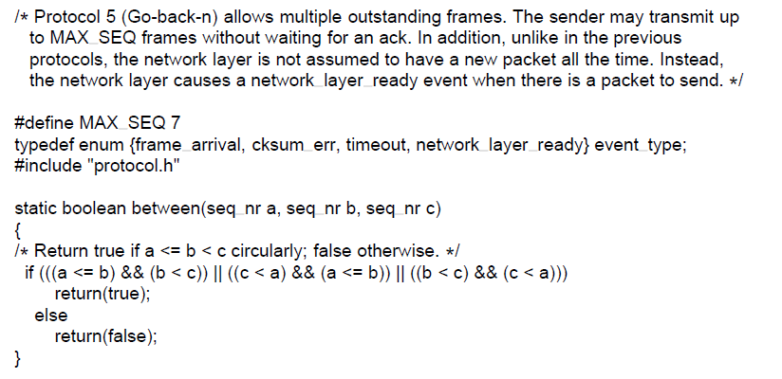
Protocol Using Go-Back-N (3)
. . .
A sliding window protocol using go-back-n.

Slide 37
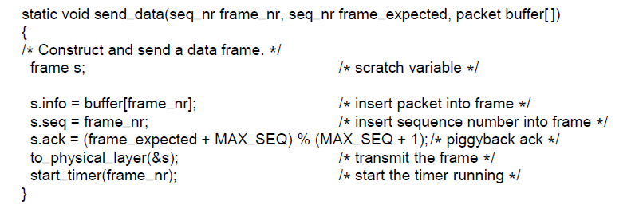
Protocol Using Go-Back-N (4)
. . .
A sliding window protocol using go-back-n.

Slide 38
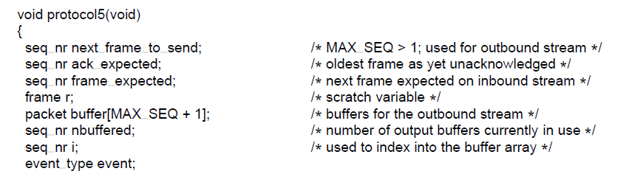
Protocol Using Go-Back-N (5)
. . .
A sliding window protocol using go-back-n.

Slide 39
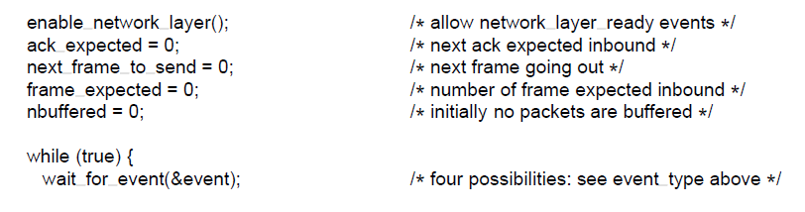
Protocol Using Go-Back-N (6)
. . .
A sliding window protocol using go-back-n.

Slide 40
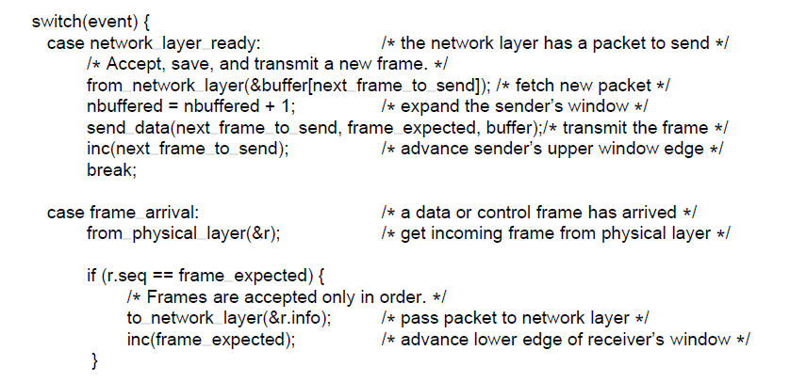
Protocol Using Go-Back-N (7)
. . .
A sliding window protocol using go-back-n.

Slide 41
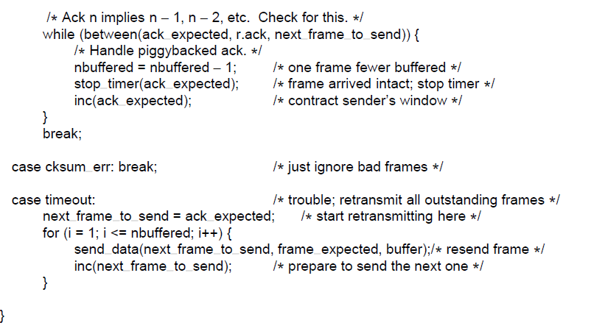
Protocol Using Go-Back-N (8)
. . .
A sliding window protocol using go-back-n.

Slide 42
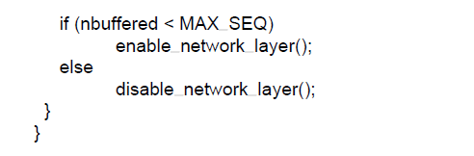
Protocol Using Go-Back-N (9)
A sliding window protocol using go-back-n.

Slide 43
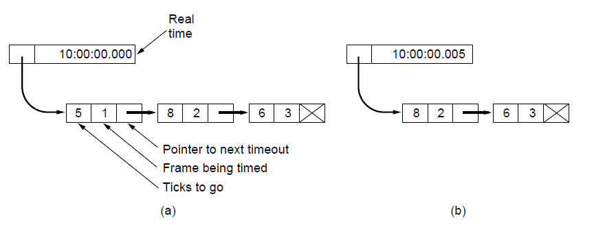
Protocol Using Go-Back-N (10)
Simulation of multiple timers in software. (a) The queued
timeouts (b) The situation after the first timeout has expired.

Slide 44
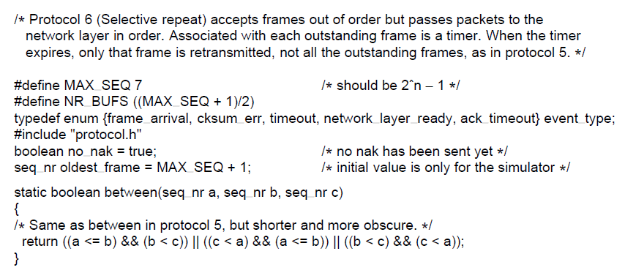
Protocol Using Selective Repeat (1)
. . .
A sliding window protocol using selective repeat.

Slide 45
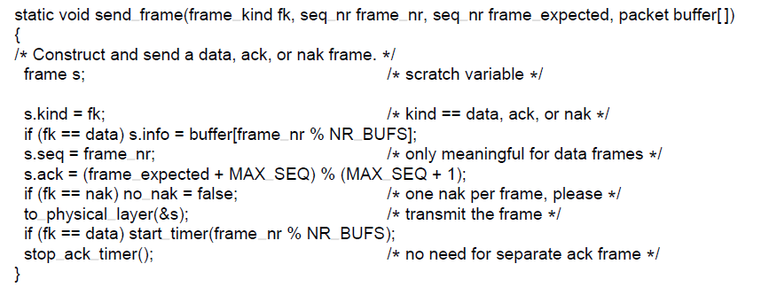
Protocol Using Selective Repeat (2)
. . .
A sliding window protocol using selective repeat.

Slide 46
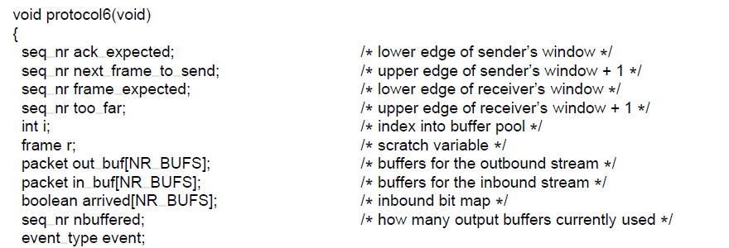
Protocol Using Selective Repeat (3)
. . .
A sliding window protocol using selective repeat.

Slide 47
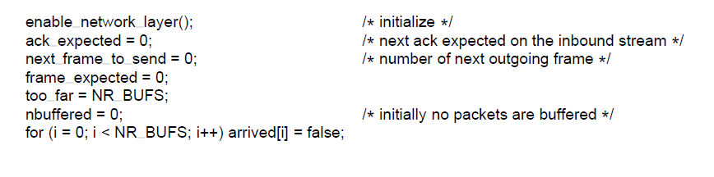
Protocol Using Selective Repeat (4)
. . .
A sliding window protocol using selective repeat.

Slide 48
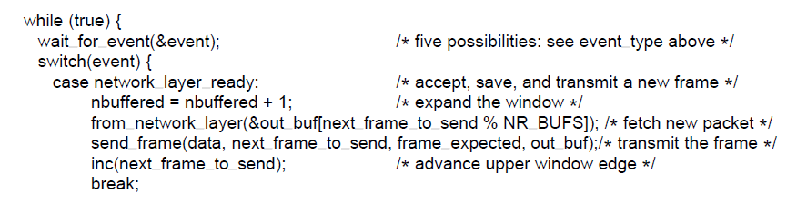
Protocol Using Selective Repeat (5)
. . .
A sliding window protocol using selective repeat.

Slide 49
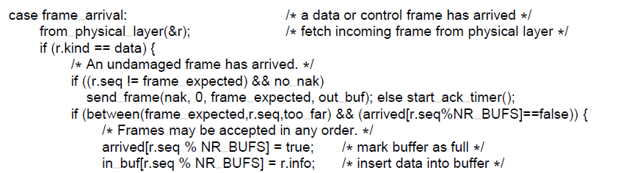
Protocol Using Selective Repeat (6)
. . .
A sliding window protocol using selective repeat.

Slide 50
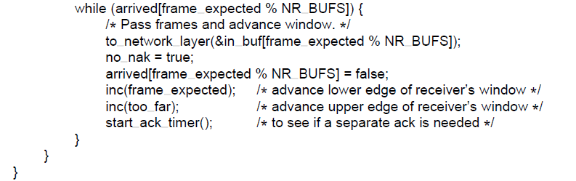
Protocol Using Selective Repeat (7)
. . .
A sliding window protocol using selective repeat.

Slide 51
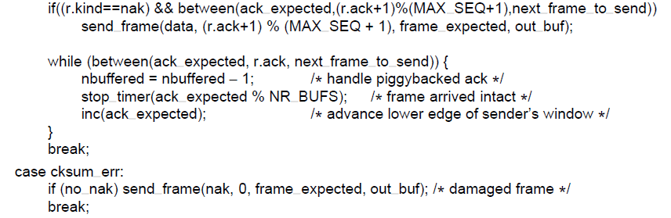
Protocol Using Selective Repeat (8)
. . .
A sliding window protocol using selective repeat.

Slide 52
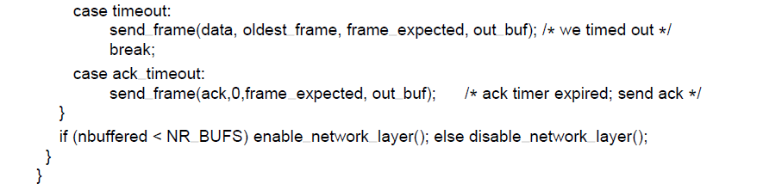
Protocol Using Selective Repeat (9)
A sliding window protocol using selective repeat.

Slide 53
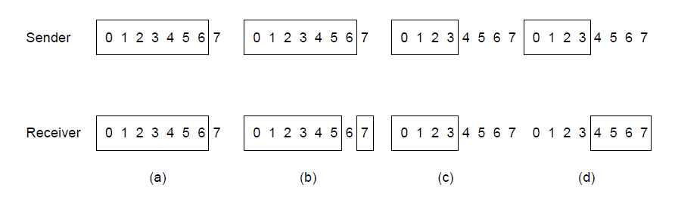
Protocol Using Selective Repeat (10)
Initial situation with a window of size7
After 7 frames sent and received but not acknowledged.
Initial situation with a window size of 4.
After 4 frames sent and received but not acknowledged.

Slide 54
Example Data Link Protocols
Packet over SONET
ADSL (Asymmetric Digital Subscriber Loop)

Slide 55
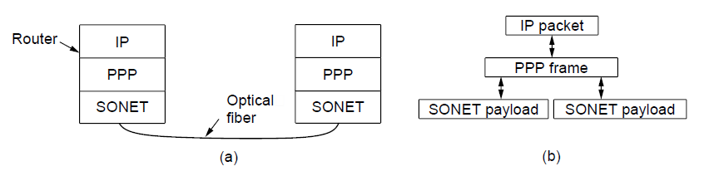
Packet over SONET (1)
Packet over SONET. (a) A protocol stack. (b) Frame relationships

Slide 56
Packet over SONET (2)
PPP Features
Separate packets, error detection
Link Control Protocol
Network Control Protocol

Slide 57
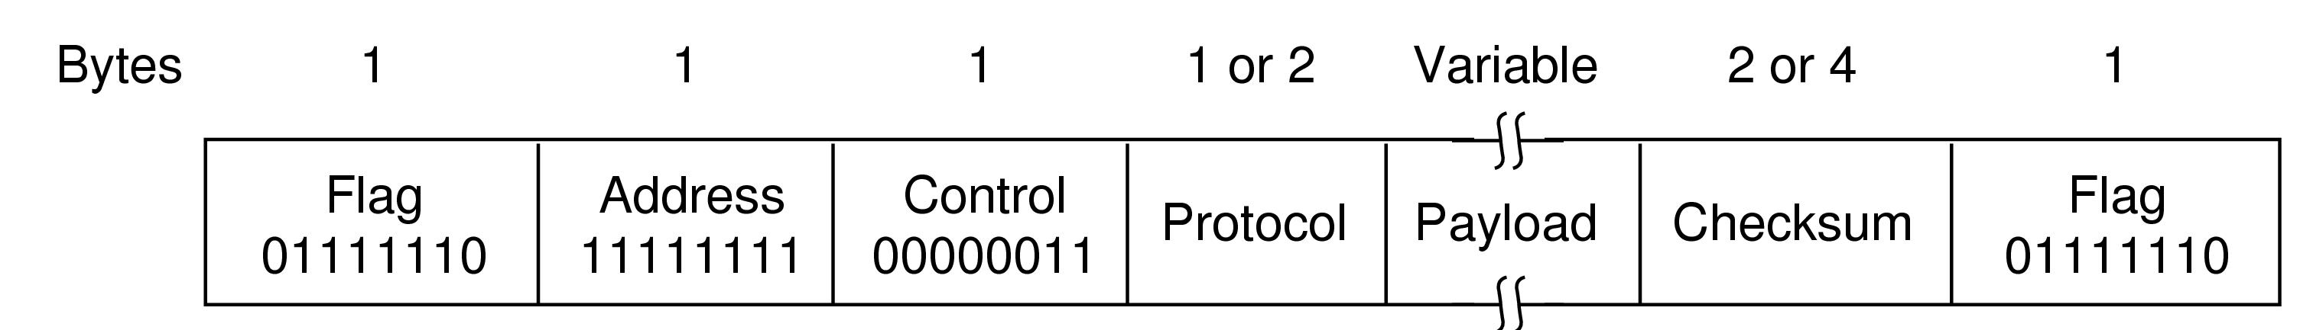
Packet over SONET (3)
The PPP full frame format for unnumbered mode operation

Slide 58
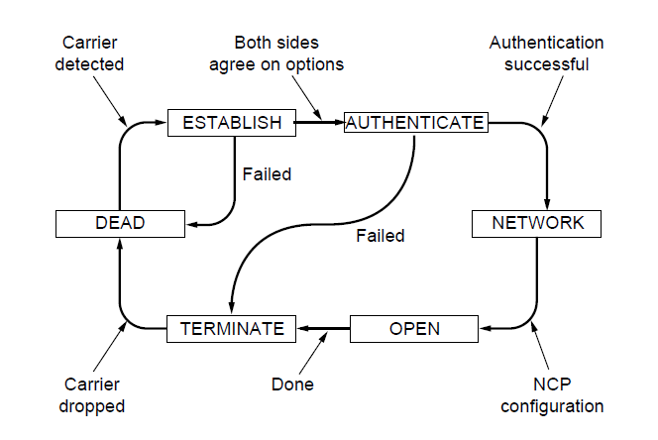
Packet over SONET (4)
State diagram for bringing a PPP link up and down

Slide 59
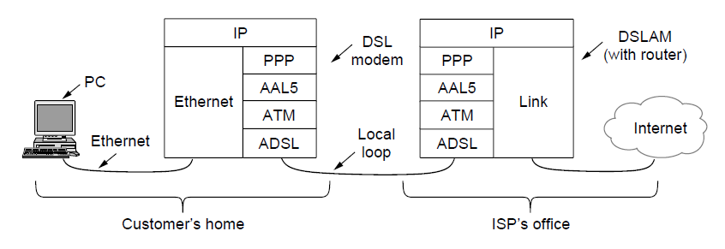
ADSL (Asymmetric Digital
Subscriber Loop) (1)
ADSL protocol stacks.

Slide 60

ADSL (Asymmetric Digital
Subscriber Loop) (1)
AAL5 frame carrying PPP data

Slide 61
End
Chapter 3

